Slide 1
UNIT-V
Database Management System:
Basic concepts of a DBMS Level
Levels of a data description
Use of a DBMS
Text editors:
Overview of Editing Process
User Interface
Editor Structure
Interactive Debugging systems:
Debugging functions and capabilities
Relationships with Other parts of the system
User Interface Criteria

Slide 2
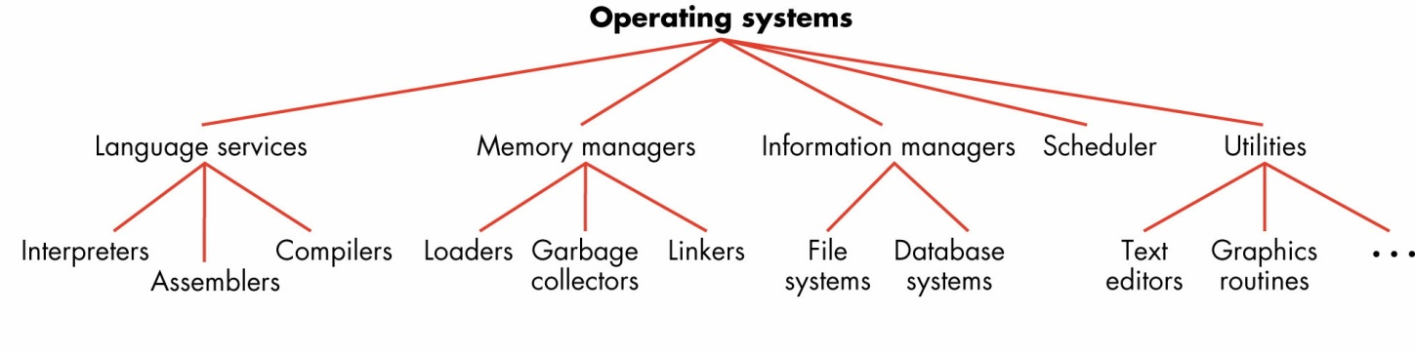
Types of System Software

Slide 3
File-Based Systems
Collection of application programs that perform services for the end users (e.g. reports).
Each program defines and manages its own data.

Slide 4
Limitations of File-Based Approach
Separation and isolation of data
Each program maintains its own set of data.
Users of one program may be unaware of potentially useful data held by other programs.
Duplication of data
Same data is held by different programs.
Wasted space and potentially different values and/or different formats for the same item.

Slide 5
Separate File Processing System
Registration System
Financial aid System
programs
Payroll system
Files

Slide 6
Integrated Data Base
Registration System
Financial aid System
programs
Payroll system
Integrated Data Base

Slide 7
Registration System
Financial aid System
Payroll system
programs
Request for Logical record
DBMS
Data Mapping operation
Physical I/O
Integrated Data Base

Slide 8
Application program request data at logical level.
DBMS determine which physical file are involved and how these files are to be accessed ,by referring to stored data mapping description.
It hen read the required records from the files of the data base and convert the information

Slide 9
Database
Shared collection of logically related data (and a description of this data), designed to meet the information needs of an organization.
System catalog (metadata) provides description of data to enable program–data independence.
Logically related data comprises entities, attributes, and relationships of an organization’s information.

Slide 10
Database Management System (DBMS)
A software system that enables users to define, create, maintain, and control access to the database.
(Database) application program: a computer program that interacts with database by issuing an appropriate request (SQL statement) to the DBMS.

Slide 11
Database Approach
Data definition language (DDL).
Permits specification of data types, structures and any data constraints.
All specifications are stored in the database.
Data manipulation language (DML).
General enquiry facility (query language) of the data.

Slide 13
Levels of a data description
The information stored by DBMS can be viewed in number of different ways, depending upon the need of the user.
Overall logical data base description called the schema.

Slide 14
Schema for university data base
Student
Faculty
advisor
ID
NAME
Address
ID
NAME
DEPT
OFFICE
Faculty employee
Payroll
ID
JOB
PAY-RATE
TAX

Slide 15
How DBMS is related to other pieces of System software
Source program with DDL commands
preprocessor
Source program with call statement
compiler
object program
DBMS

Slide 16
User Interface
User interface is one, which allows the user to communicate with the system in order to perform certain tasks.

Slide 17
INPUT DEVICES:
The input devices are used to enter elements of text being edited,
Input devices are categorized as:
1) Text devices
2) Button devices
3) Locator devices

Slide 18
Text devices
Text or string devices are typically typewriter like keyboards on which user presses and release keys, sending unique code for each key.
Virtually all computer key boards are of the QWERTY type.

Slide 19
Button or Choice devices
Button or Choice devices generate an interrupt
special function keys are available on the key board.

Slide 20
Locator device
Locator devices are two-dimensional analog-to-digital converters
The most common such devices for editing applications are the mouse

Slide 21
voice input device
Voice-input devices, which translate spoken words to their textual equivalents

Slide 22
OUTPUT DEVICES
The output devices let the user view the elements being edited and the result of the editing operations
teletypewriters
Cathode Ray Tube (CRT)

Slide 23
Text editors
A text editor is a type of program used for editing plain text files.

Slide 24
Overview of Editing Process
1. select the part of the target document to be
viewed and manipulated.
2. Determine how to format this view on-line and
how to display it.
3. Specify and execute operations that modify the
target document.
4. Update the view appropriately.

Slide 25
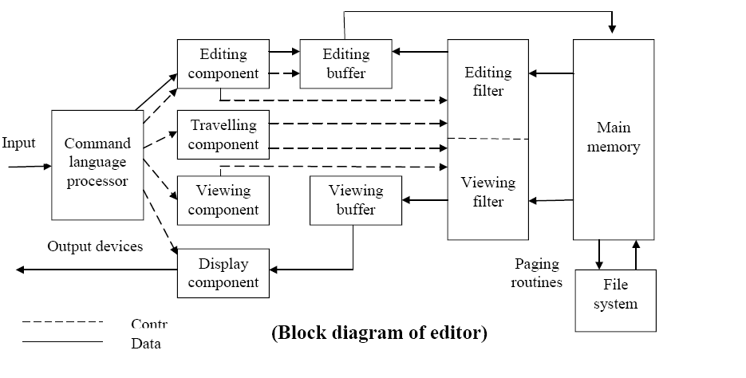
Editor Structure

Slide 26
The command Language Processor
It accepts input from the user's input devices, and analyzes the tokens and syntactic structure of the commands.

Slide 27
Editing Component
In editing a document, the start of the area to be edited is determined by the current editing pointer maintained by the editing component, which is the collection of modules dealing with editing tasks.

Slide 28
Traveling Component
The traveling component of the editor actually performs the setting of the current editing and viewing pointers

Slide 29
Viewing Component
The start of the area to be viewed is determined by the current viewing pointer.
This pointer is maintained by the viewing component of the editor, which is a collection of modules responsible for determining the next view.

Slide 30
Display Component
The display component produces a display by mapping the buffer to a rectangular subset of the screen, usually a window

Slide 31
Editing Filter
The editing filter filters the document to generate a new editing buffer based on the current editing pointer as well as on the editing filter parameters

Slide 32
Viewing Filter
This component filters the document to generate a new viewing buffer based on the current viewing pointer as well as on the viewing filter parameters.

Slide 33
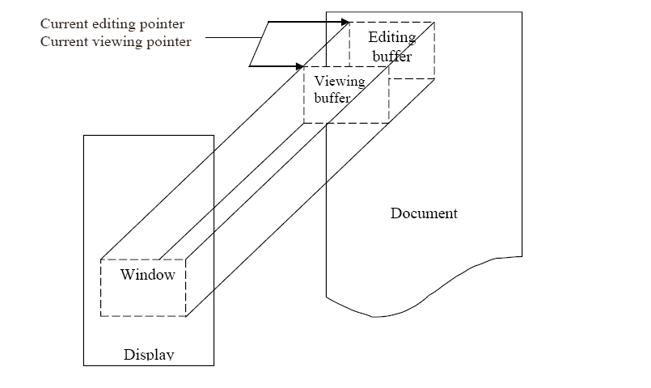

Slide 34
Interactive Debugging systems
An interactive debugging system provides programmers with facilities that aid in the testing and debugging of programs.

Slide 35
Breakpoints
The programmer may define break points which cause execution to be suspended, when a specified point in the program is reached.
After execution is suspended, the debugging command is used to analyze the progress of the program and to diagnose errors detected.

Slide 36
Conditional Expressions
Programmers can define some conditional expressions, evaluated during the debugging session, program execution is suspended, when conditions are met,

Slide 37
Gaits
useful in running the program in various speeds called gaits.

Slide 38
Tracing
Tracing can be used to track the flow of execution logic and data modifications.

Slide 39
Traceback
Trace back can show the path by which the current statement was reached

Slide 40
Program-display Capabilities
Debugging system should have a good program display capabilities. It must be possible to display the program being debugged, complete with statement numbers.

Slide 41
Debugging Function and Capabilities:
The debugger should be able to switch its context when a program written in one language calls a program written in a different language.
A debugging system must be able to deal with optimized code. Application code used in production environments is usually optimized.

Slide 42
User Interface Crteria
Full – screen displays and windowing systems
Command language:
On Line HELP facility

Slide 43
User Interface Criteria:
Command formats should be as flexible as possible.
The command language should minimize the use of such punctuation as parentheses, slashes, quotation marks and other special characters.
Any good interactive system should have an online HELP facility.

Slide 44
User Interface Crteria:
The user interaction should make use of full screen displays and windowing system as much as possible.
The advantage of this type is that a great deal of information can be displayed and changed easily and quickly. with menus and full screen editors, the, user has far less information to enter and remember.
If the tasks a user needs to perform are reflected in the organization of menus, then the system will feel very natural to use. Menu should have titles that identify the task they help perform. Directions should precede any choices available to the user.

